Slide 1


Slide 2
PROJECT-TITLE: CHALLENGES IN BULDING SCALABLE OPERATING SYSTEMS FOR SUPERCOMPUTERS
A COMPREHENSIVE REVIEW
PRESENTED BY: PRAMODH NARAIN
CHANNEL: PRAMODH CODE CRAFTER
COURSE: COMPUTER SCIENCE AND ENGINEERING [DATA SCIENCE]
BATCH: 2ND YEAR ; 3RD SEMESTER
DATE:

Slide 3
ACKNOWLEDGMENT
I would like to express my heartfelt gratitude to my Operating Systems teacher, for their invaluable guidance, unwavering support, and encouragement throughout the duration of this project. Their expertise, insightful feedback, and continuous motivation played a crucial role in shaping the direction and outcome of this work. Without their assistance and advice, this project would not have been as successful I truly appreciate their time and effort in helping me achieve my objectives !

Slide 4

INTRODUCTION
Importance of Operating Systems:
Critical for managing resources
in computers
Essential for high-performance
computing (HPC).
Scope of the Case Study:
Explore challenges in scalability of
supercomputer Operating System.

Slide 5

PROBLEM STATEMENT
Description of the Problem:
Managing vast resources
across thousands of nodes.
Importance of the Problem:
Impacts efficiency in research
and technological advancement.

Slide 6

METHODOLOGY
Approach Taken:
Review of literature and
case studies.
Tools and Techniques Used:
Message Passing Interface (MPI):
Communication between nodes.
Distributed File Systems:
Efficient data management
Resource Scheduling Algorithms:
Optimal resource allocation

Slide 7

ANALYSIS
Key Challenges Identified:
Concurrency management.
Inter-node communication.
Fault tolerance.
Resource scheduling.
Solutions or Techniques Used:
Load balancing and dynamic
scheduling.
Fault-tolerance algorithms.
Efficient inter-node communication
with MPI.

Slide 8
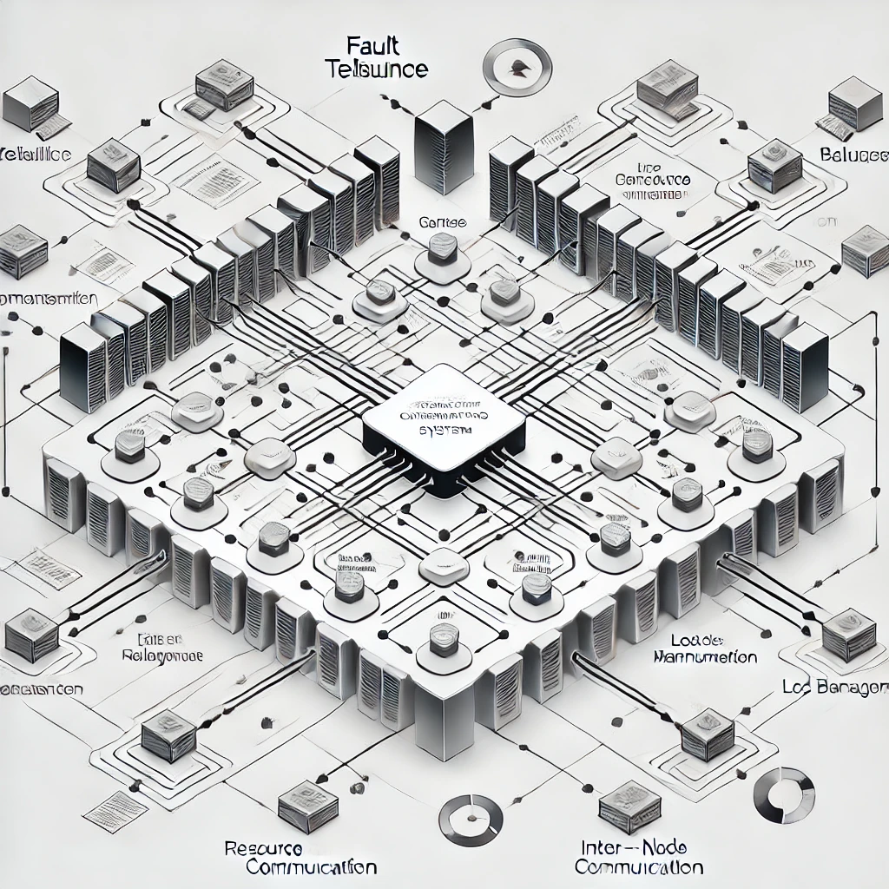
DIAGRAM
Architecture Overview:
Architecture of a scalable OS for supercomputers
Explanation:
Illustrate resource management and communication protocols.

Slide 9
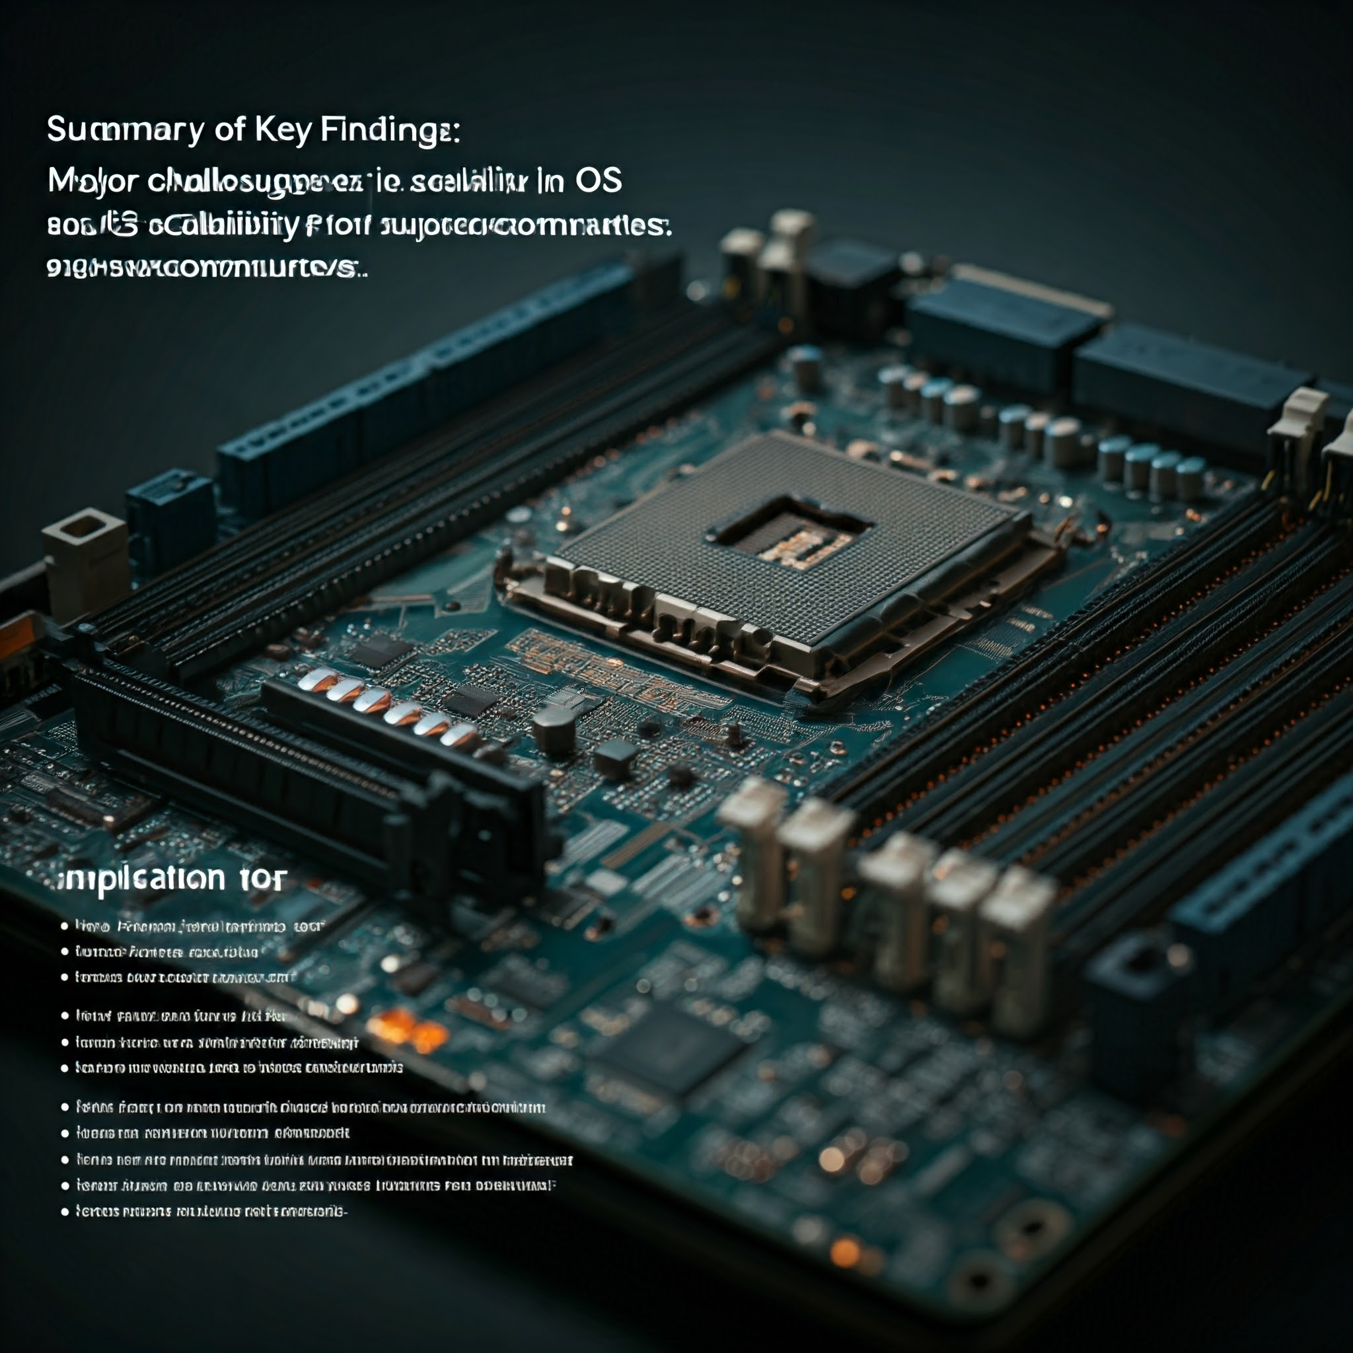
CONCLUSION
Summary of Key Findings:
Major challenges in OS
scalability for supercomputers
Implications for Future Research:
Need for improved scalability
and fault tolerance.
Focus on optimizing communication
and resource allocation.

Slide 10

THANK YOU
I would like to extend my sincere
thanks to my operating systems
teacher for their invaluable guidance
and support throughout this project.
Your expertise and encouragement
have been instrumental in helping me
complete this work.
I also appreciate the opportunity to
learn and grow through this
experience.

